Slide 1


Introduction to Water Chemistry & Hardness
Course Code: ETMLCH104
Course Name: Engineering Chemistry
Program: B.Tech. (AI/ML)
Unit1:Water technology & Chemical Fuels
Dr. Mehak Ahuja
Assistant Professor, Department of Chemistry
School of Basic and Applied Sciences
K.R. Mangalam University
Sohna Road, Gurugram

Slide 2

Course Overview
Unit Number: 1 | Title: Water technology | No. of hours: 6
Introduction, water analysis: Hardness-determination by EDTA method, Treatment of boiler feed water: Internal treatment (Phosphate, Colloidal and Calgon conditioning). External treatments: Ion exchange and lime-soda process, Zeolite processes. Boiler scales formation and ill effects, methods of prevention of scales. Numerical problems
Unit Number: 2 | Title: Chemical Fuels | No. of hours: 9
Fuels: Introduction, classification, calorific value (HCV & LCV), Determination of calorific value of fuel using Bomb calorimeter. Solid fuel: Coal- its analysis by proximate and ultimate analysis, Numerical problems. Liquid fuels: Refining of petroleum, Petroleum cracking, Knocking in IC engine, its ill effects and prevention of knocking. Anti-knocking agent: Leaded and unleaded petrol. Gaseous fuels: LPG, CNG and their applications.
Unit Number: 3 | Title: Battery Technology | No. of hours: 10
Introduction - Galvanic cell, electrode potential, EMF of the cell and cell representation. Batteries and their importance, Classification of batteries- primary, secondary and reserve batteries with examples. Battery characteristics - voltage, capacity, energy density, power density, energy efficiency, cycle life and shelf life. Construction, working and applications of: Ni-Cd, and Lithium-ion battery. Working principle of an electric vehicle.
Unit Number: 4 | Title: Polymer | No. of hours: 5
Basic concepts of polymer, Types of polymers, Thermoplastic & thermosetting plastics, Preparation and application of some industrially important polymers (Natural rubber, Buna S, Buna-N, Neoprene, Isoprene, Nylon-6, nylon-6,6 , Decron and Terylene). Conducting and biodegradable polymers.

Slide 3
COURSE OUTCOMES
CO1: Understand the methods for water hardness and the basics of boiler water treatment and analyze fuel calorific values and battery.
CO2: Explain the characteristics and working principles of different battery types and types of fuels.
CO3: Determine the differences between batteries and fuel cells and classify fuel cell types based on their components..
CO4: Identify between hard and soft water, solve the related numerical problems on water purification and emf and its significance in industry and daily life.

Slide 4

calorific value (HCV & LCV)

Slide 5

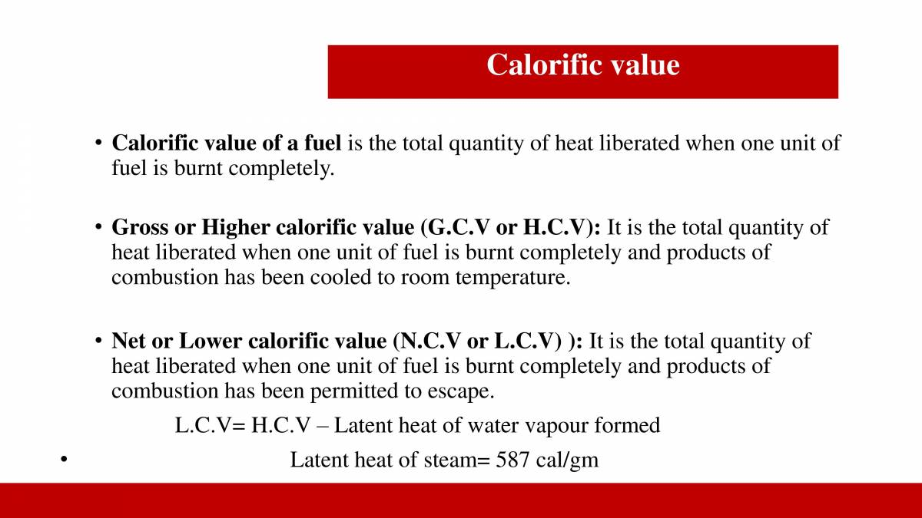
Calorific Value
Notes:
New Courses replaced with New Programmes

Slide 6
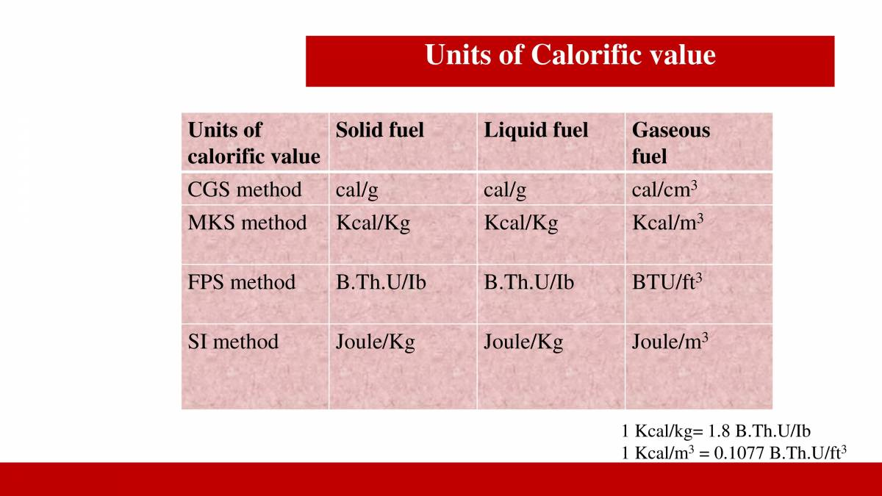
Units of calorific Value

Slide 7

Ideal Fuels: Calorific Value and Characteristics
This will discuss the concept of calorific value and its importance in fuel selection. We will explore the characteristics of an ideal fuel, examining hydrogen and LPG as prime examples. We will also compare the calorific values of various fuels and analyze their pros and cons.
AA
Notes:
1

Slide 8

What is Calorific Value?
Calorific Value
Units
Calorific value refers to the amount of heat energy released when a specific amount of fuel undergoes complete combustion.
It's typically measured in units like joules per gram (J/g) or kilojoules per gram (kJ/g).
Notes:
2

Slide 9
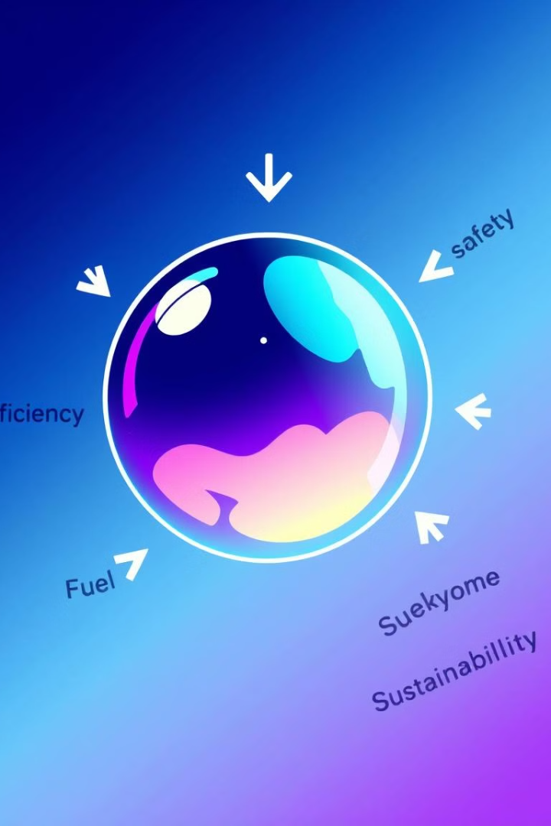

Characteristics of an Ideal Fuel
High Calorific Value
Easy Availability and Transportability
Releases a significant amount of energy per unit mass.
Accessible and readily transported to where it's needed.
High Energy Density
Clean Combustion with Minimal Residue
Stores a large amount of energy in a small volume or mass.
Burns efficiently with minimal pollution and waste products.
Notes:
3

Slide 10
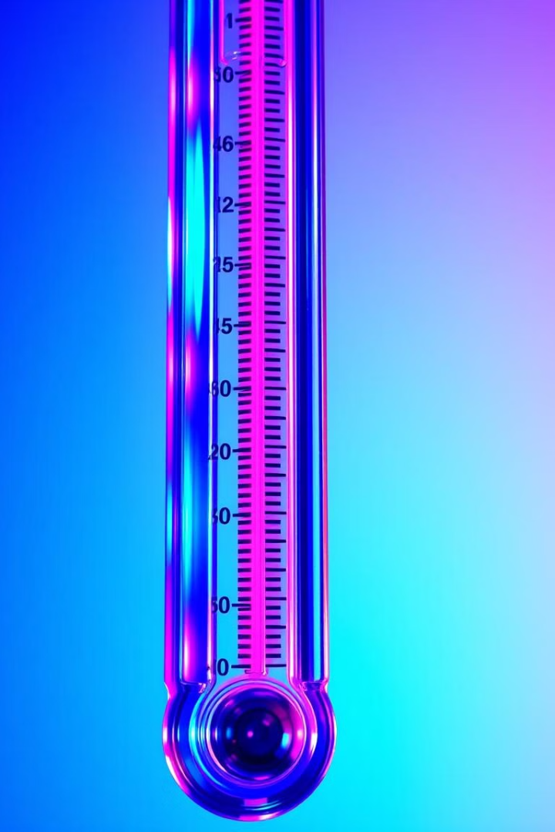
High Calorific Value
100
High Energy Release
A fuel with high calorific value provides a large amount of energy for a given amount of fuel.
Notes:
4

Slide 11
Easy Availability and Transportability
Accessibility
Transportability
The fuel should be readily available in the desired quantities and at reasonable costs.
Easy to transport and store without significant risks or safety concerns.
Notes:
5

Slide 12
High Energy Density
High Energy Storage
1
Allows for more compact storage and easier transportation.
Notes:
6

Slide 13


Clean Combustion with Minimal Residue
Efficient Combustion
1
Burns completely with minimal waste products.
2
Low Emissions
Minimizes pollution and environmental impact.
Notes:
7

Slide 14
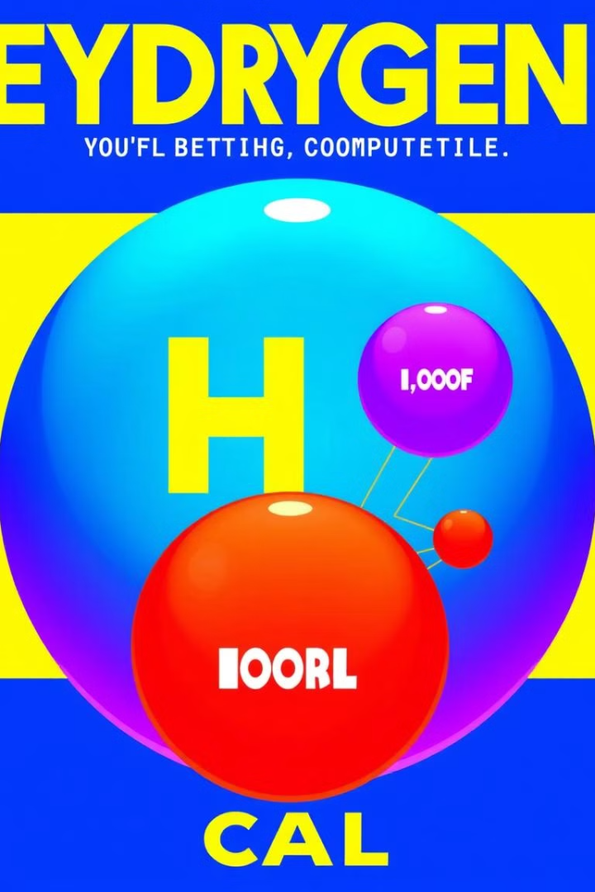
Comparison of Calorific Values of Different Fuels
Fuel
Calorific Value (kJ/g)
Wood
15-20
Coal
25-35
Natural Gas
48-55
LPG
46-50
Hydrogen
142
Notes:
8

Slide 15
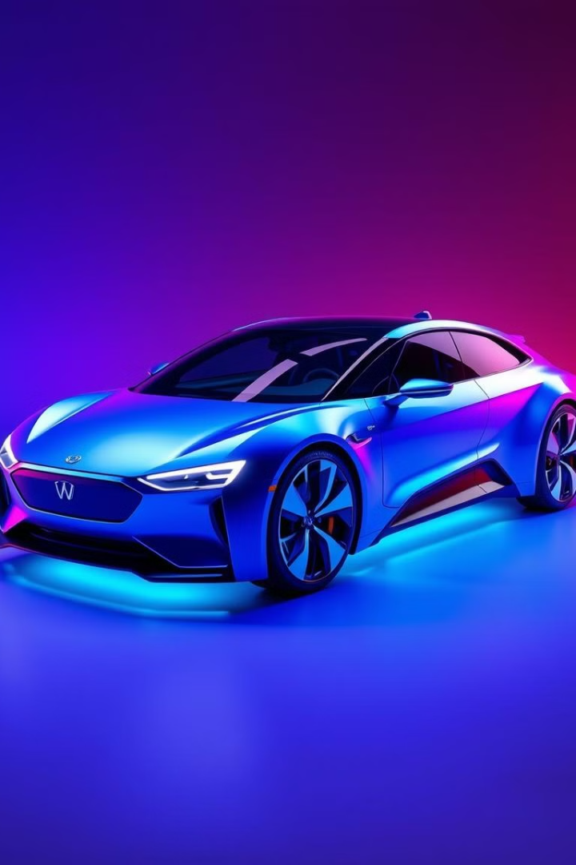


Advantages of Hydrogen as an Ideal Fuel
High Calorific Value
Clean Combustion
Hydrogen has the highest calorific value among common fuels, making it a potent energy source.
Burns cleanly, producing only water as a byproduct, reducing emissions and pollution.
Notes:
9

Slide 16



Advantages of LPG as an Ideal Fuel
High Energy Density
Versatility
Stores a significant amount of energy in a compact form, making it suitable for transportation and storage.
LPG can be used in various applications, including cooking, heating, and powering vehicles.
Notes:
10

Slide 17
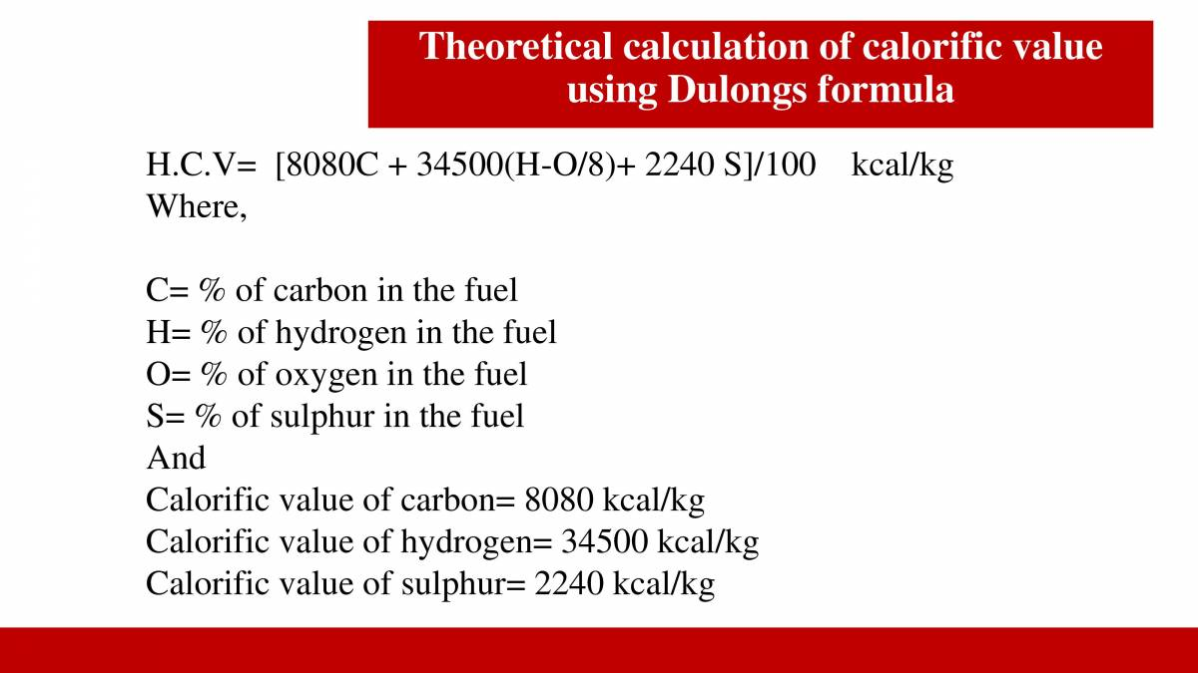
Theoretical calculation of Calorific Value by Dulong’s Formula

Slide 18
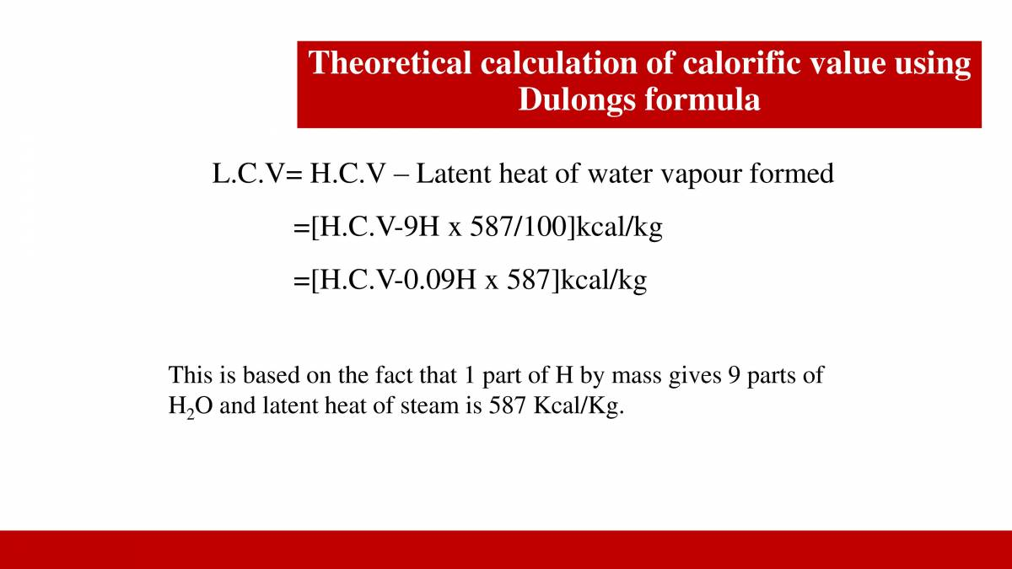


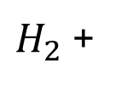
$H_{2}$ +
$$O_{2}$$
$${H_{2}O}_{}$$
2 g 32 g 18 g

Slide 19
QUESTION FOR PRACTICE
A sample of coal has following composition by mass C = 70 %, O = 8 %, H = 10 %, N = 3 %, S = 2%, Ash = 7 %. Calculate H.C.V. and L.C.V. using Dulong’s formula
SOLUTION:
HCV = 1/100[8080 C+34500(H-O/8) +2240 S]
= 1/100[8080 + 70+34500(10-8/8) +2240 X
= 1/100 [565600 + 34500 (10-1) X 4480] = 1/100 [565600 + 310500 + 4480]
= 1/100 [880580]
= 8805.80kcal/kg
LCV = [ HCV- 9/100 H X 587] kcal/kg
= [8805.80-9/100 x 587]
= [8805.80- 528.30]
= 8277.80 kcal/kg
Answer: HCV/GCV = 8805.80kcal/kg and LCV/NCV = 8277.80 kcal/kg

Slide 20
Take away of the session
Definition: Calorific value is the amount of heat produced when 1 unit mass of fuel is completely burned.
Units: Usually expressed in kJ/kg, kcal/kg, or kJ/m³ for gases.
Types:
Higher Calorific Value (HCV): Includes latent heat of steam (condensation of water formed during combustion).
Lower Calorific Value (LCV): Excludes latent heat of steam; assumes water remains as vapour.
Relation: HCV is always greater than LCV.
Importance: Used to evaluate fuel efficiency in industries, boilers, and engines.

Slide 21
Questions
1. What does calorific value represent? A. Temperature of the fuel B. Heat required to ignite fuel C. Heat produced on complete combustion D. Mass of fuel ✅ Answer: C
2. Which of the following includes latent heat of water vapor? A. LCV B. HCV C. Both D. Neither ✅ Answer: B
3. Which calorific value is usually lower? A. HCV B. LCV C. Both are equal D. Depends on the temperature ✅ Answer: B
4.. The calorific value of gaseous fuels is usually expressed in: A. kJ/kg B. kcal/g C. kJ/m³ D. kWh ✅ Answer: C
5. Why is HCV greater than LCV? A. It includes heat losses B. It includes latent heat of water vapor C. It ignores combustion D. It measures temperature instead of heat ✅ Answer: B

Slide 22
Learning Outcomes
CO1: Understand the methods for water hardness and the basics of boiler water treatment and analyze fuel calorific values and battery.
CO2: Explain the characteristics and working principles of different battery types and types of fuels.
BTL-1: Recall definitions and types of fuels (CO2)
BTL-2: Explain characteristics of solid, liquid, and gaseous fuels;
define calorific value (CO1, CO2)
BTL-3: Apply knowledge to identify ideal fuels and solve questions
related to fuel properties (CO1, CO2)
Mapped Course Outcomes

Slide 23
References
Engineering Chemistry by Jain and Jain.

